Slide 1
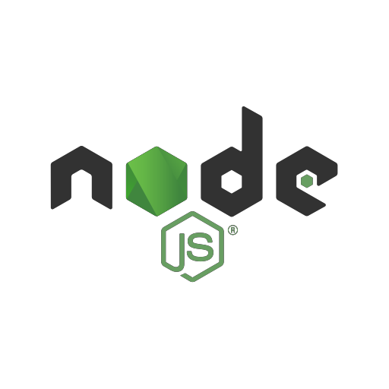
The Server -side JavaScript
Day 1

Slide 2
Agenda
Intro to Node JS
Install Node JS
How JavaScript work
Node JS Ecosystem
Fly in Severs ☺
Play with files ☺

Slide 3
INTRODUCTION: BASIC
In simple words Node.js is ‘server-side JavaScript platform’.
Node.js is a platform for JavaScript applications running out side browser.
Node.js is a high-performance network applications framework.
Its an Open Source, Cross-platform, runtime environment for server- side and a high performance networking applications.
Cross platform: can be installed on UNIX/Linux/Mac OS X, SunOS and Windows.
Node is the official name of the project, NodeJS.
Created by Ryan Dahl in 2009.
Its built in v8 chrome engine (Node.js runs on V8).
V8 is an open source JavaScript engine developed by Google. Its written in C++ and is used in Google Chrome Browser.
Very Fast Being built on Google Chrome's V8 JavaScript Engine,
Node.js library is very fast in code execution.
It’s a command line tool.

Slide 4
How JavaScript work?
First should explain some terminology should know to get what I say next
synchronous and asynchronous
Synchronous: operations tasks are performed one at a time and only when one is completed, the following is unblocked. In other words, you need to wait for a task to finish to move to the next one.
Asynchronous: operations, on the other hand, you can move to another task before the previous one finishes.

Slide 5
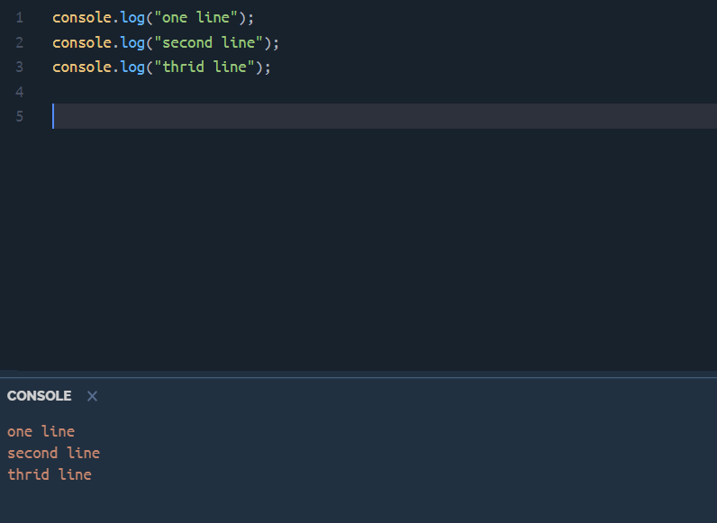
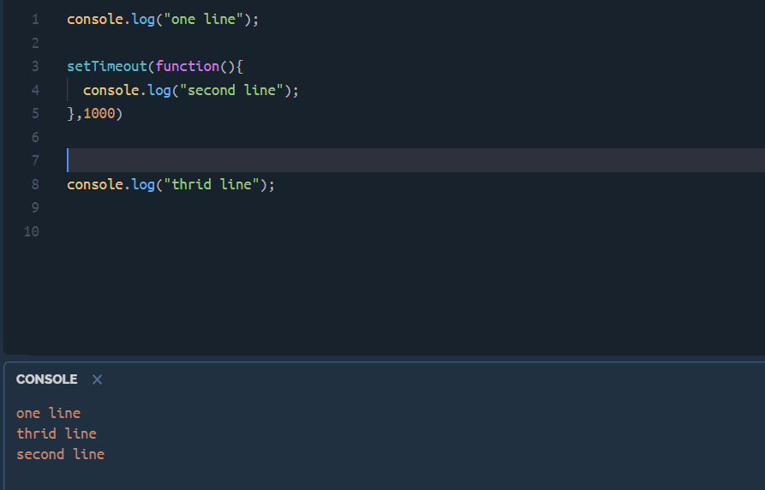
Synchronous | Asynchronous

Slide 6
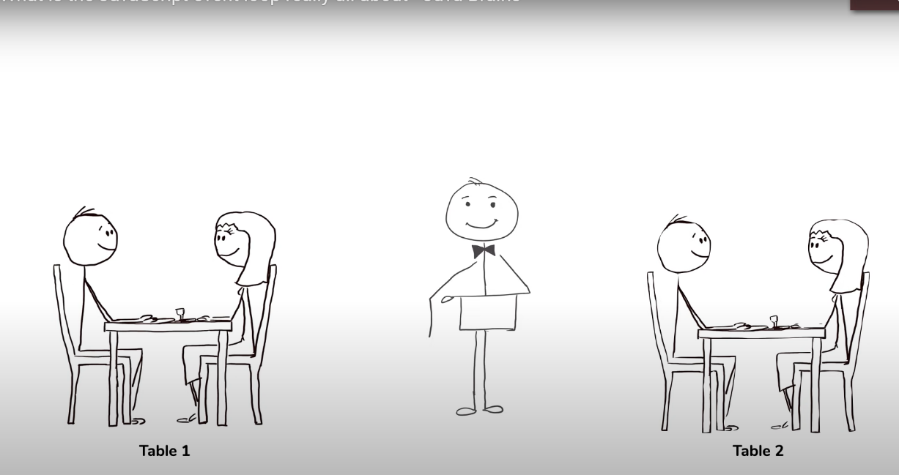
Single thread vs. multi thread

Slide 7
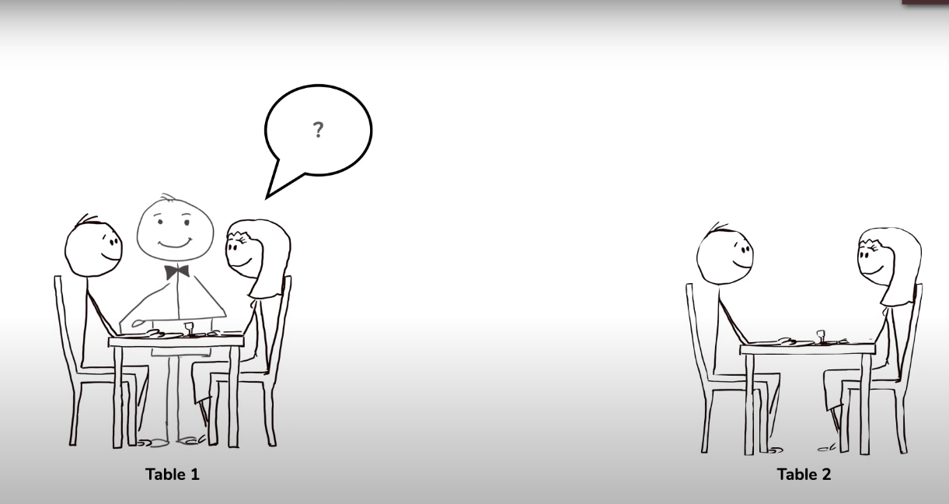
Single thread vs. multi thread

Slide 8
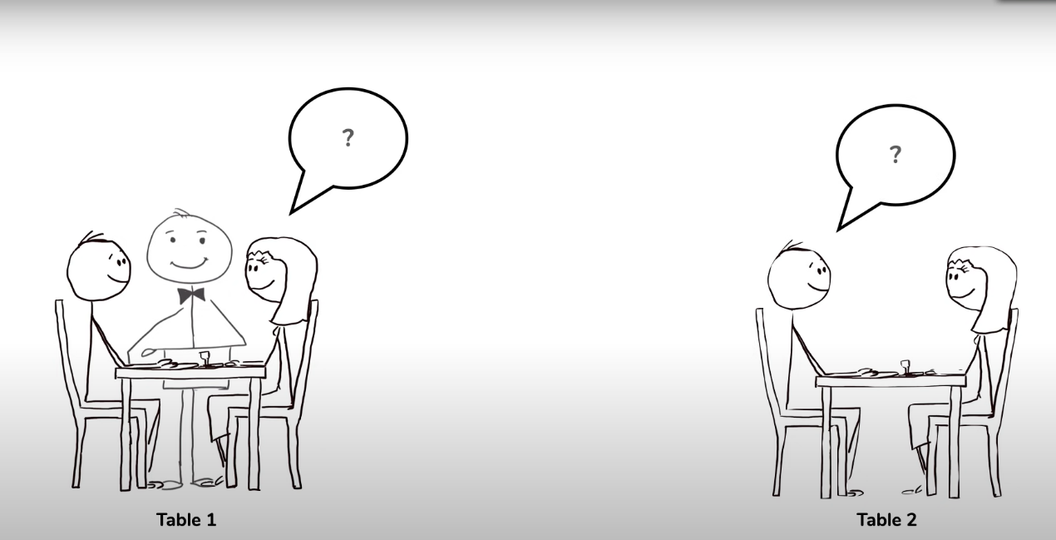
Single thread vs. multi thread
Problem???

Slide 9
Event loop in JavaScript
Event loop structure:
Call stack
WebApis
Callback queue
Event loop

Slide 10
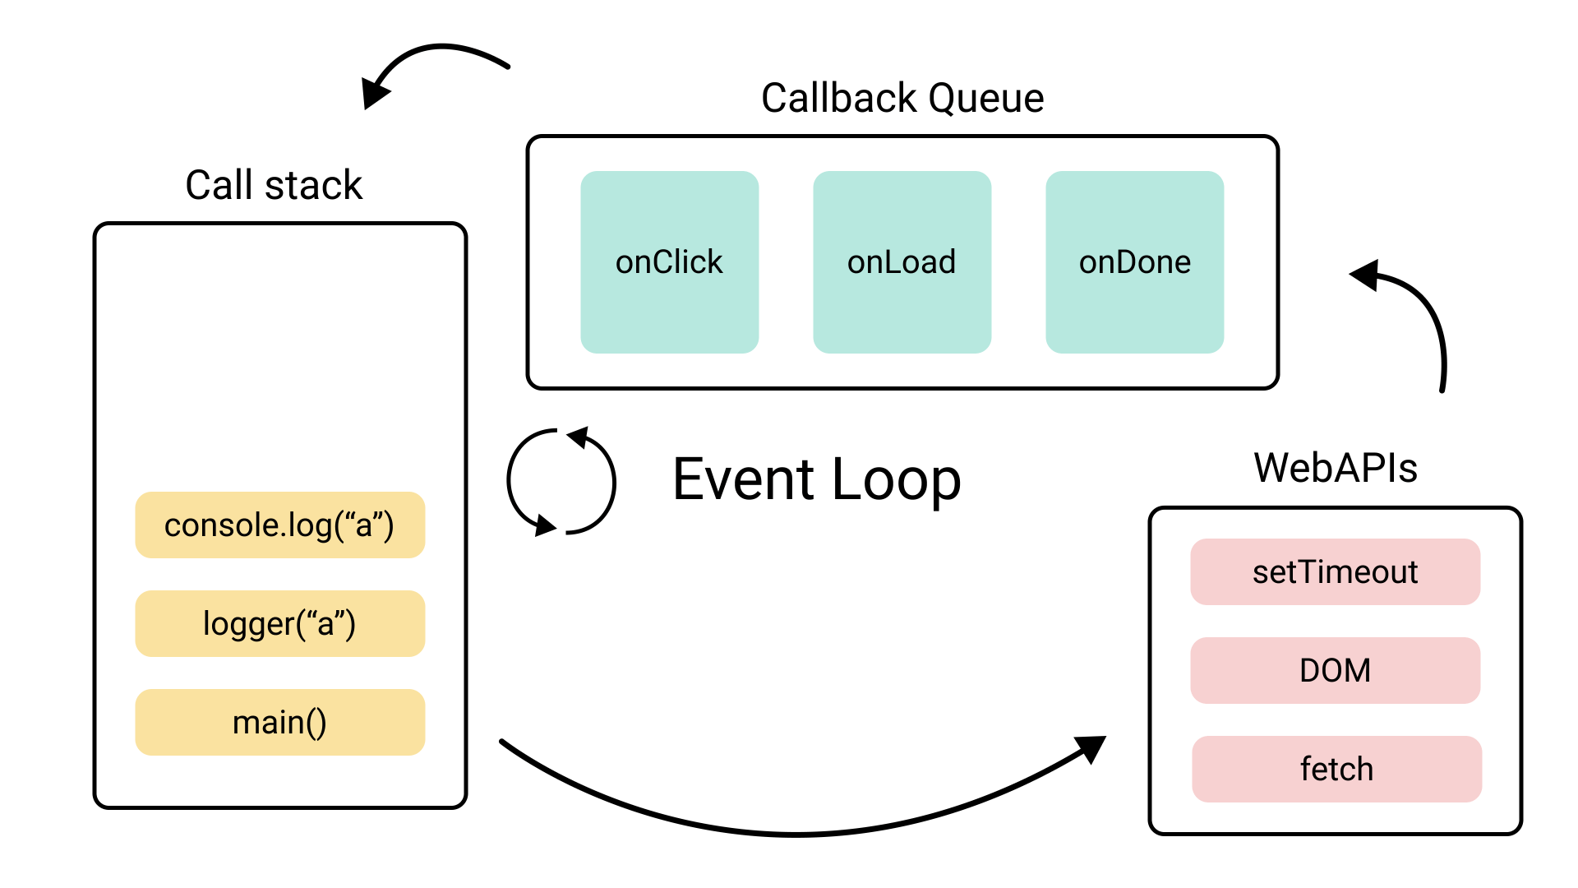
Event loop in JavaScript

Slide 11
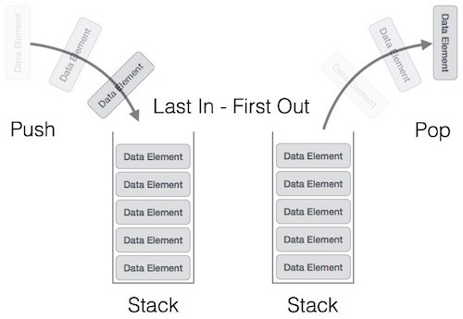
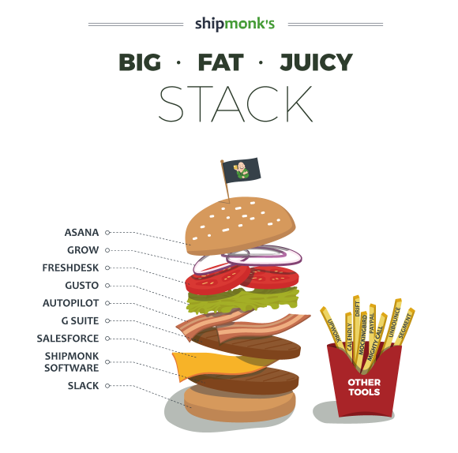
Call stack

Slide 12
Call stack
Call stack is provided by JavaScript runtime (V8 for example).
As a single threaded programming language JavaScript has only one call stack.
This means that only one thing can be executed at a time.
Call stack is simply a place where these executable contexts are placed in order for getting executed.
Call stack follows the LIFO principle (Last In First Out).

Slide 13
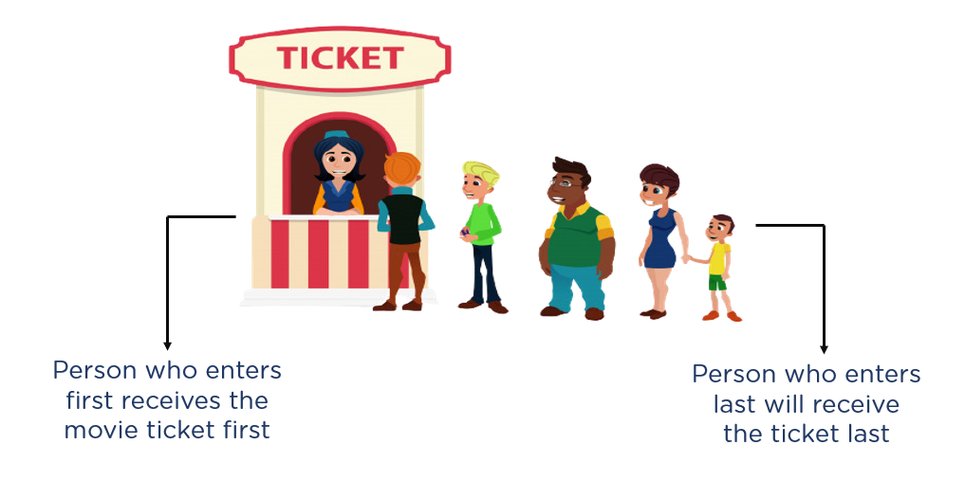
Callback queue

Slide 14
Event loop
WebAPIs are APIs provided by the browser.
They kind of work as an artificial extra threads and allow us to execute multiple things at the same time for certain cases.
Callback queue is a queue where callback functions gets pushed from the WebAPIs once they have finished.
The Event Loop has only one simple job to do. It looks at the Call Stack and Callback Queue, if the Call Stack is empty, it pushes the first callback function of the Callback Queue to the Call Stack.

Slide 15
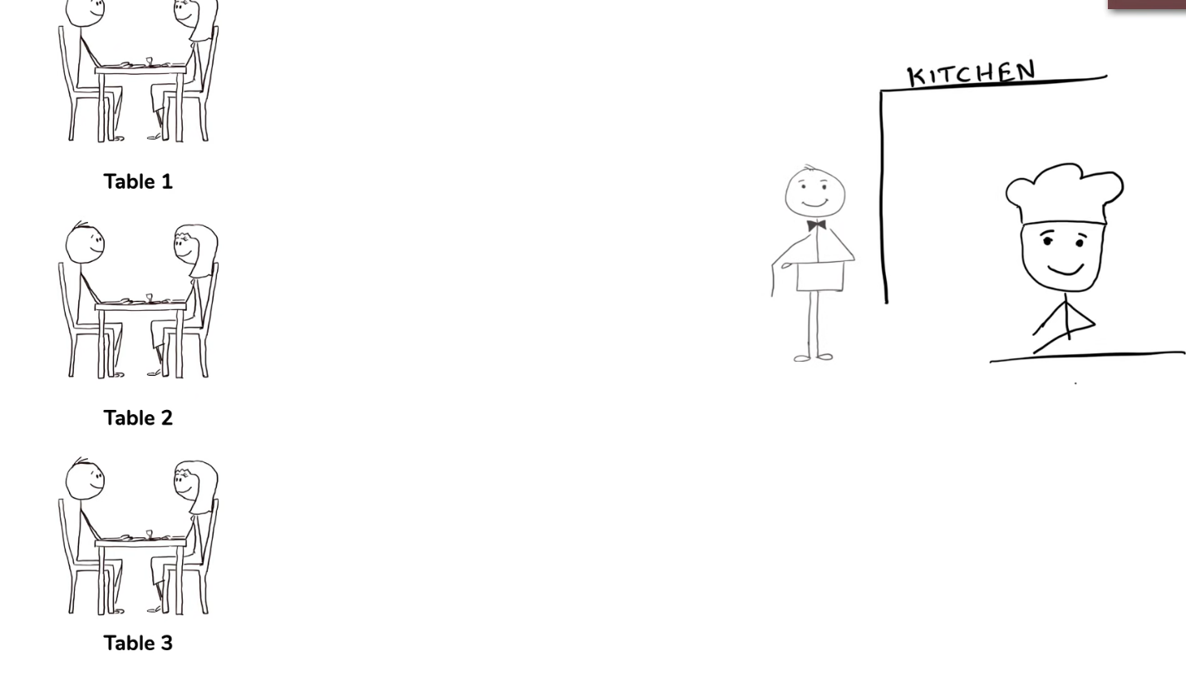
Event loop

Slide 16
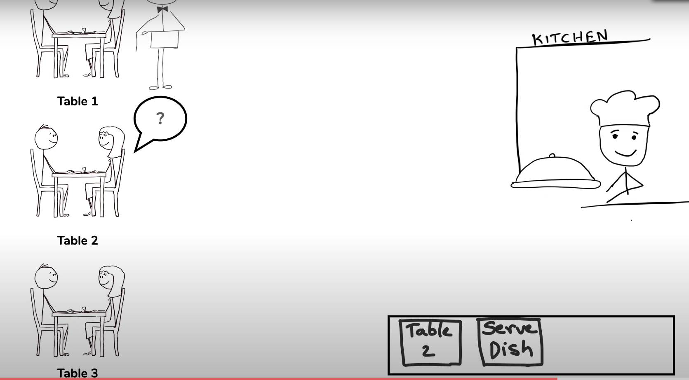
Event loop

Slide 17
WHAT CAN YOU DO WITH NODE.JS ?
Node.js is designed for DIRT applications.
DIRT stands for : data-intensive real-time applications
e.g. video streaming, SPAs, networking apps
Following are the areas where Node.js is perfect technology:
I/O bound Applications
Data Streaming Applications
Data Intensive Real time Applications (DIRT)
JSON APIs based Applications
Single Page Applications
You can create an HTTP server and print ‘hello world’ on the browser in
just 4 lines of JavaScript.
You can create a TCP server similar to HTTP server, in just 4 lines of JavaScript.
You can create a DNS server.
You can create a Static File Server.
You can create a Web Chat Application like GTalk in the browser.
Node.js can also be used for creating online games, collaboration tools or anything which sends updates to the user in real-time.

Slide 18
WHEN TO USE NODE.JS?
Node.js is good for creating streaming based real-time services, web chat applications, static file servers etc.
If you need high level concurrency and not worried about CPU- cycles.
If you are great at writing JavaScript code because then you can use the same language at both the places: server-side and client- side.
More can be found at: http://stackoverflow.com/questions/5062614/how-to-decide- when-to-use-nodejs

Slide 19
WHEN TO NOT USE NODE.JS?
When you are doing heavy and CPU intensive calculations on server side, because event-loops are CPU hungry.
Node.js is a no match for enterprise level application frameworks like Spring(java), Django(python), Symfony(php), ASP.Net SignalR (Microsoft) … etc. Applications written on such platforms are meant to be highly user interactive and involve complex business logic.
Node can’t run on GUI, but run on terminal/cmd
Read further on disadvantages of Node.js on Quora: http://www.quora.com/What-are-the-disadvantages-of-using- Node-js

Slide 20
WHO IS USING NODE.JS IN PRODUCTION?
Yahoo! : iPad App Livestand uses Yahoo! Manhattan framework which is based on Node.js.
LinkedIn : LinkedIn uses a combination of Node.js and MongoDB for its mobile platform. iOS and Android apps are based on it.
eBay : Uses Node.js along with ql.io to help application developers in improving eBay’s end user experience.
Dow Jones : The WSJ Social front-end is written completely in
Node.js, using Express.js, and many other modules.
Microsoft, PayPal, Uber, …

Slide 21
GETTING STARTED & HELLO WORLD
Open your favorite editor and start typing JavaScript.
Here is a simple example, which prints ‘hello world’
 Ex.1:
/* Hello, World! program in node.js */ console.log("Hello, World!");
 Ex.2:
/* Hello, World! program in node.js */
console.log("Hello, ");
setTimeout(function(){ console.log("NodeJS world!");
}, 3000);
//it prints ‘hello’ first and waits for 3 seconds and then prints
‘world’
When you are done, open cmd/terminal and type this:
node YOUR_FILE.js

Slide 22
NODE.JS ECOSYSTEM
Node.js heavily relies on modules.
Creating a module is easy, just put your JavaScript code in a separate js file and include it in your code by using keyword require, like:
var modulex = require(‘./modulex’);
Module is a self contained series of one or more .js files presented by an object.
Modules is where we can encapsulate related functionality into a single file.
Should be accessible from outside the file.
Modules act as libaries
It’s a set reusable code that adds extra functionality to our application.
Modules allow Node to be extended.
It allows us to install packages/modules, and publish our custom one and share them with other developers.
Node provides core modules that can be included by their name:
File System – require(‘fs’)
Http – require(‘http’)

Slide 23
NODE.JS - FIRST APPLICATION (HTTP MODULE)
A Node.js application consists of following three important parts:
Import required modules − We use require directive to load a Node.js module.
Create server − A server which will listen to client's request similar to
Apache HTTP Server.
Read request and return response − server created in earlier step will read HTTP request made by client which can be a browser or console and return the response.

Slide 24
NODE.JS - FIRST APPLICATION (HTTP MODULE) – CONT.
Creating Node.js Application:
Step 1: Import required module
We use require directive to load http module and store returned HTTP instance into http variable as follows
var http = require("http");
Step 2: Create Server
At next step we use created http instance and call http.createServer() method to create server instance and then we bind it at port 8081 using listen method.
http.createServer(function (request, response) {
// Send the HTTP header
// HTTP Status: 200 : OK
// Content Type: text/plain
response.writeHead(200, {'Content-Type': 'text/plain'});
// Send the response body as "Hello World"
response.end('Hello World\n');
}).listen(8081);
// Console will print the message
console.log('Server running at http://127.0.0.1:8081/');

Slide 25
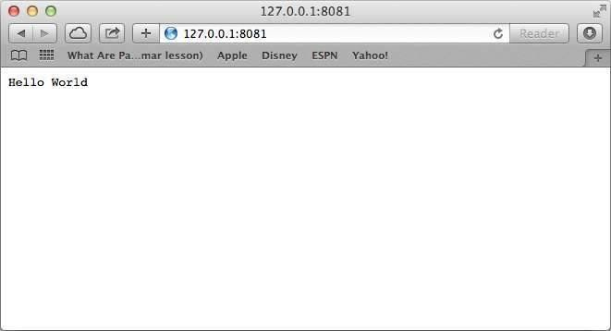
NODE.JS - FIRST APPLICATION (HTTP MODULE) – CONT.
Creating Node.js Application (Cont.):
Step 3: Testing Request & Response
Let's put step 1 and 2 together in a file called main.js.
Open command prompt and execute the main.js to start the server
node main.js
Make a request to Node.js server
Open http://127.0.0.1:8081/ in any browser and see the below result.

Slide 26
NODEJS- STREAMS
Streams are objects that let you read data from a source or write data to a destination in continous fashion.
In Node.js, there are four types of streams.
Readable - Stream which is used for read operation.
Writable - Stream which is used for write operation.
Duplex - Stream which can be used for both read and write operation.
Transform - A type of duplex stream where the output is computed based on input.
Each type of Stream is an EventEmitter instance and throws several events at different instance of times. For example, some of the commonly used events are:
data - This event is fired when there is data is available to read.
end - This event is fired when there is no more data to read.
error - This event is fired when there is any error receiving or writing data.
finish - This event is fired when all data has been flushed to underlying system

Slide 27
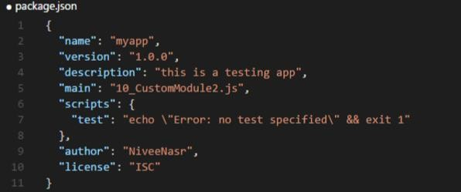
PACKAGE.JSON
It’s a file that contains txt info about project’s loaded
modules
It can build or rebuild node-module folder
Most important fields are name & version.

Slide 28
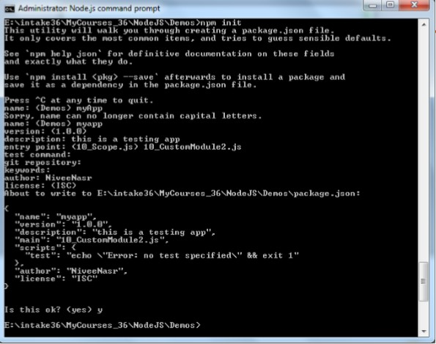
PACKAGE.JSON - INITIALIZATION
Initialize it use:
npm init

Slide 29
MOST KNOWN NODEJS-BASED FRAMEWRKS AND MODULES
Other frameworks that will make it easier using node
Express – to make things simpler e.g. syntax, DB connections.
Jade, Ejs – HTML template system (view engines)
Socket.IO – to create real-time apps
Nodemon – to monitor Node.js and push change automatically
Redis – in memory DB
MongoDB

